Slide 2
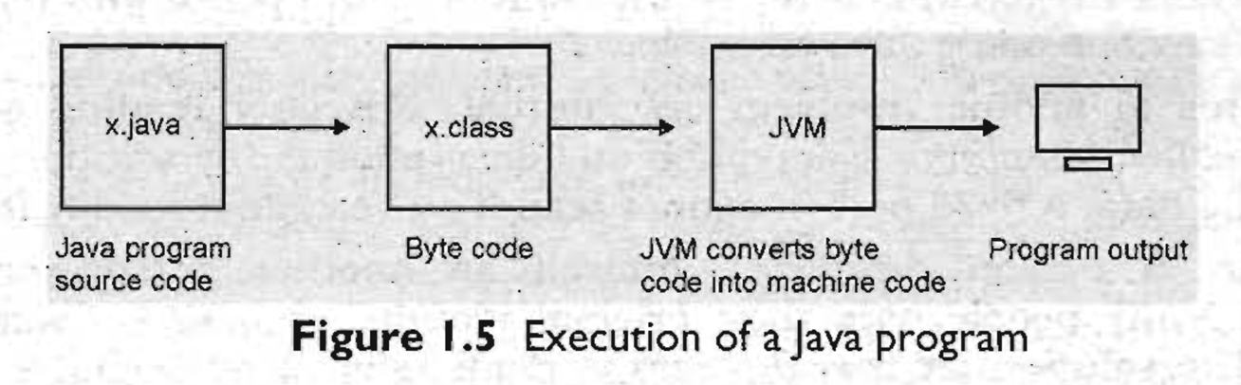
In Java, if we write a program, it is stored with an extension .java. Let us create a program, say x.java. It contains java source code statements.
Now, the: first step is to compile this x. java program. To do that, Java compiler first translates the x.java program into x.class file.
What will be there in x.class file?
Java people coined or named a group of instructions to express any operation - byte code instructions.
These instructions are called byte code instructions because the size of each instruction is 1 byte (=8 bits) exactly.
There are a fixed number of byte code instructions, around 200.
Any java program can be rewritten using these few byte code instructions.
That file is called x.class.
So, we can say that a x.class file contains source code equivalent to byte code.
Ref: book: Core Java: An Integrated Approach, By R. Nageswara Rao/kogent Solutions.

Slide 3
But the microprocessor cannot understand byte code instructions, neither can it execute them.
Then, these byte code instructions are meant for whom?
They are for JVM (Java Virtual Machine)
These byte code instructions are understandable by JVM, --which is a program written to understand the byte code instructions and convert them into machine code.
JVM's role is very crucial in a way that - it has to first identify the operating system and processor used in the computer system and then convert the byte code instructions in an understandable format for that particular processor and operating system.
Remember, JVM is not a machine-it is a program!
Figure 1.5 shows how a java- source code passes through various stages before being executed by the compiler.
Ref: book: Core Java: An Integrated Approach, By R. Nageswara Rao/kogent Solutions.

Slide 4
On Internet, different computer systems with different processors and different operating systems are available,
but still Java programs will run on any system and produce the same results on all the systems.
If we develop a software using Java, the .class files can be downloaded from Internet and can be executed on any other computer system without any problem.
Hence, Java is a suitable programming language for-software development on Internet.
Ref: book: Core Java: An Integrated Approach, By R. Nageswara Rao/kogent Solutions.

Slide 5
Features of Java

Slide 6
Simple:
Java is a simple programming language.
Rather than saying that this is the feature of Java, we can say that this is the design aim of Java.
When 'Java is developed, they wanted it to be simple because it has to work on electronic devices, where less memory is available.'
Now the question is how Java is made simple?
First of all, the difficult concepts of C and C++ have been omitted in Java.
For example, the concept of pointers - which is very difficult for both learners and programmers-has been completely eliminated from Java.
Next, JavaSoft (the team who develoPed Java is called with this name) people maintained the same syntax of C and C++ in Java, so that a programmer who knows C or C++ will find Java already familiar.
Ref: book: Core Java: An Integrated Approach, By R. Nageswara Rao/kogent Solutions.

Slide 7
Quick Question:
Why pointers are eliminated from Java?
Pointers lead to confusion for a programmer.
Pointers may crash a program easily, for example, when we add two pointers, the program, crashes immediately.
The same thing could also happen when we forgot to free the memory allotted to a variable and reallot it to some other variable.
Pointers break security.
Using pointers, harmful programs like Virus and other hacking programs can be developed.
Because of the above reasons, pointers have been eliminated from Java.
Ref: book: Core Java: An Integrated Approach, By R. Nageswara Rao/kogent Solutions.

Slide 8
Object-oriented:
Java is an object,oriented programming language.
This means Java programs use objects and classes.
What is an Object?
An object is anything that really exists in the world and can be distinguished from others.
Everything that we see physically will come into this definition,
for example, every human being, a book, a tree, a car, a phone, a house, and so on.
Now, every object has properties and exhibits certain behavior. Let us try to illustrate this point by taking an example of a dog.
It got properties like name, height; color, 'age, etc. These properties are represented by variables.
Now, the- object dog will have some actions like running, barking, eating, etc. These actions are represented by various methods (functions) in our programming.
In programming, various tasks are done by methods only.
So, we can conclude that objects contain variables and methods.
Ref: book: Core Java: An Integrated Approach, By R. Nageswara Rao/kogent Solutions.

Slide 9
Object-oriented:
Java is an object,oriented programming language.
This means Java programs use objects and classes.
What is an Class?
A group of objects exhibiting same behavior (properties + actions) will come under the same group called a class.
A class represents a group name given to several objects.
For example, take the dogs: tommy, max, charlie, and dobby. All these four dogs exhibit same behavior and hence belong to the same group, called dog.
So dog is the class name, which contains four objects.
In other words, we could define a class as a model or a blueprint for creating the objects.
We write the characteristics of the objects in the class: 'dog'. This means, a class can be used as a model in creation of objects.
So, Just like objects, a class also contains properties and actions, i.e. variables and methods
Ref: book: Core Java: An Integrated Approach, By R. Nageswara Rao/kogent Solutions.

Slide 10
Other features:
Distributed: Information is distributed on various computers on a network. This is possible because Java can handle the protocols like TCP/IP and UDP
Robust: Robust means -strong. Java programs are strong and they don't crash easily like a C or C++ program. There are two reasons -for this. Firstly, Java has got excellent inbuilt exception handling features. An exception is an error that occurs at run time.
Memory management features: Most of the C and C++ programs crash in the' middle because of not allocating sufficient memory or forgetting the memory to be freed in a program. In Java, everything will be taken care of by JVM only. For example, JVM will allocate the necessary memory needed by a Java program.
Secure: Security problems can be eliminated or minimized by using Java on Internet.
System independence: Java's bytecode is not machine dependent. It can be run on any machine with any processor and any operating system.
Portability: If a program yields the same result on every machine, then that program is called portable. Java programs are portable.
Ref: book: Core Java: An Integrated Approach, By R. Nageswara Rao/kogent Solutions.

Slide 11
Other features:
Interpreted: Java programs are compiled to generate the byte code. This byte code can be downloaded and interpreted by the interpreter in JVM. If we take any other language, only an interpreter or a compiler is used fo execute the programs. But in Java., we use both compiler and interpreter for the execution.
High Performance: JIT (Just In Time) compiler, which enhances the speed of execution.
Multithreaded: A thread represents an individual process to execute a group of statement JVM uses several threads to execute different blocks of code. Creating multiple threads is called ‘multithreaded'.
Scalability: Java platform can be implemented on a wide range of computers
Dynamic: applet program - dynamically interacting programs on Internet.
Ref: book: Core Java: An Integrated Approach, By R. Nageswara Rao/kogent Solutions.

Slide 12
Java Editions Overview
1. Java SE (Standard Edition)
Java SE contains the basic core Java classes.
It is used to develop standard applets and applications.
This edition provides the foundational tools and libraries for creating simple, standalone applications.
2. Java EE (Enterprise Edition)
Java EE includes classes beyond Java SE.
In fact, Java SE is required in order to use many of the classes in Java EE.
Java EE is focused on providing business solutions in networked environments.
It is used to build large-scale enterprise applications like web applications and distributed systems.
3. Java ME (Micro Edition)
Java ME is designed for developers creating code for portable devices such as PDA or cellular phones.
It is intended for devices with limited resources where code needs to be small in size and use less memory.
Java ME is perfect for developing applications that run on mobile devices and embedded systems.

Slide 13
Comments:
There are three types of comments in Java: single-line, multi-line, and Java documentation comments.
Single-line comments: These comments are used to mark a single line as a comment. They begin with the double slash symbol //, and everything written after this symbol, until the end of the line, is considered a comment. Example: // This is a single-line comment
Multi-line comments: These comments are used to represent several lines as comments. They start with /* and end with */. Everything written between /* and */ is treated as a comment, regardless of how many lines it spans. Example: /* This is a multi-line comment that spans multiple lines. */

Slide 14
Java documentation comments: These comments start with /** and end with */. They are used to provide descriptions for every feature in a Java program. This description helps in the creation of an HTML file called the API (Application Programming Interface) document. Java documentation comments should be used before every feature in the program. Example: /** * This is a Java documentation comment. * It is used to generate API documentation. */ public void myMethod() { // method body }

Slide 15
Java library
I
Packages
I
Classes and interfaces
I
Methods
In our first Java program, we are using two classes: System and String. These classes belong to a package called java.lang (where lang represents the language). However, in Java, the java.lang package is automatically imported by default, so we don't need to explicitly import these classes.
public class HelloWorld {
public static void main(String[] args) {
// This is the entry point of the program
System.out.println("Hello, World!");
}
}

Slide 16
import java.lang.String;
import java.lang.System;
import java.lang.*;
In our first Java program, we are using two classes: System and String. These classes belong to a package called java.lang (where lang represents the language). However, in Java, the java.lang package is automatically imported by default, so we don't need to explicitly import these classes.
public class HelloWorld {
public static void main(String[] args) {
// This is the entry point of the program
System.out.println("Hello, World!");
}
}

Slide 17
import java.lang.String;
import java.lang.System;
import java.lang.*;
*Whenever We want to import several classes of the same package
In our first Java program, we are using two classes: System and String. These classes belong to a package called java.lang (where lang represents the language). However, in Java, the java.lang package is automatically imported by default, so we don't need to explicitly import these classes.
public class HelloWorld {
public static void main(String[] args) {
// This is the entry point of the program
System.out.println("Hello, World!");
}
}

Slide 18
Data Types in Java
Java provides two main types of data types:
Primitive Data Types
Non-Primitive Data Types

Slide 19
Primitive Data Types - Primitive types are the most basic data types built into Java.
Data Type | Size | Min Value | Max Value | Example
byte | 1 byte | -128 | 127 | byte b = 100;
short | 2 bytes | -32,768 | 32,767 | short s = 1000;
int | 4 bytes | -2,147,483,648 | 2,147,483,647 | int num = 50000;
long | 8 bytes | -9,223,372,036,854,775,808 | 9,223,372,036,854,775,807 | long bigNum = 100000L;
float | 4 bytes | ±1.4E-45 | ±3.4E+38 | float pi = 3.14f;
double | 8 bytes | ±4.9E-324 | ±1.8E+308 | double precise = 99.99;
char | 2 bytes | \u0000 (0) | \uffff (65,535) | char grade = 'A';
boolean | 1 bit | false | true | boolean isJavaFun = true;

Slide 20
Non-Primitive Data Types - These are more complex data types that store references to objects.
Data Type | Description | Example
String | A sequence of characters | String name = "Java";
Array | A collection of elements of the same type | int[] numbers = {1, 2, 3};
Class | A blueprint for objects | class Student { }
Interface | A contract for implementing classes | interface Animal { }

Slide 21
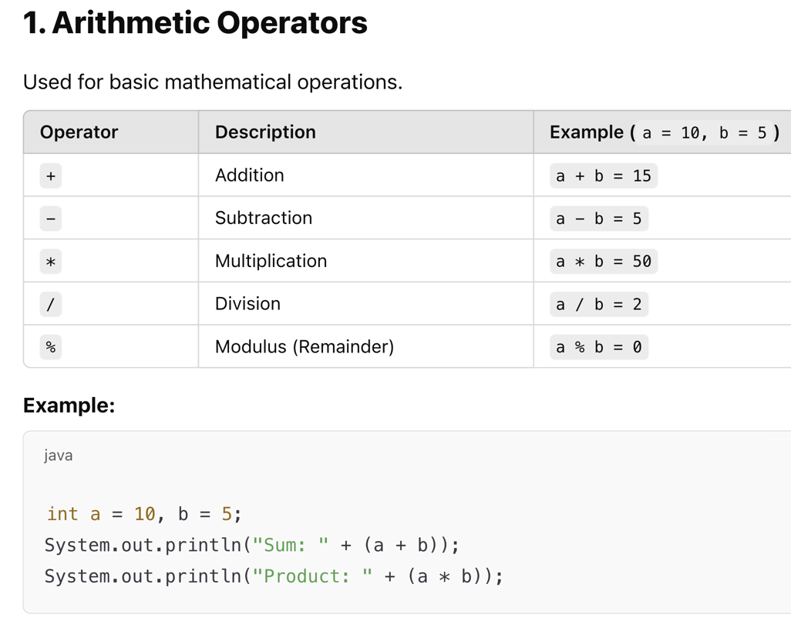

Slide 23
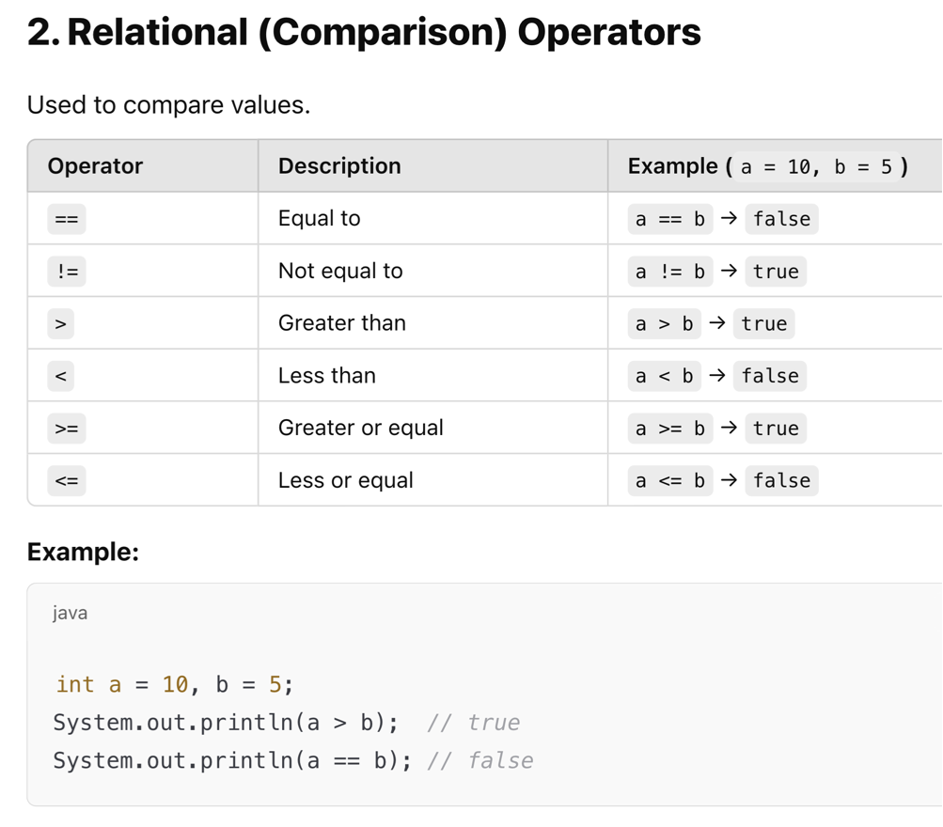

Slide 25
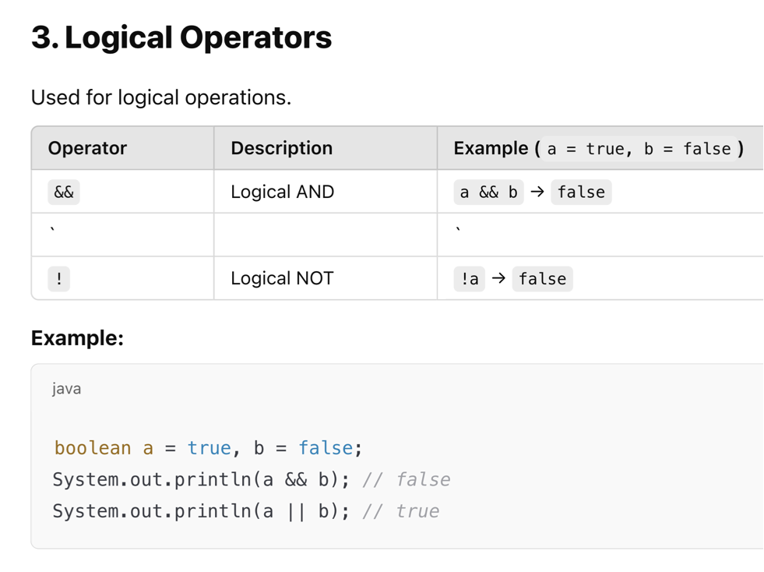

Slide 27
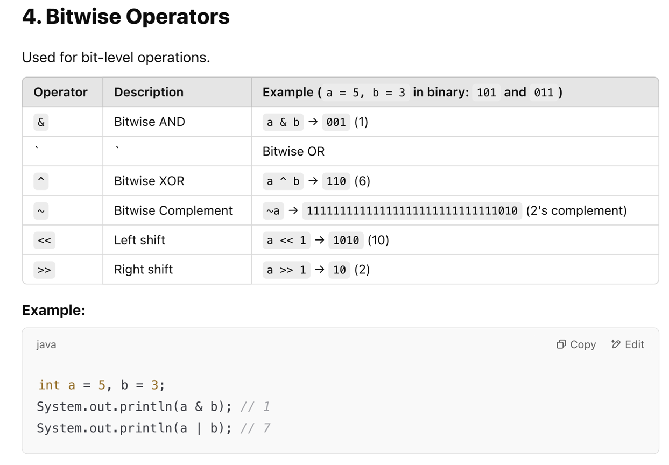

Slide 29
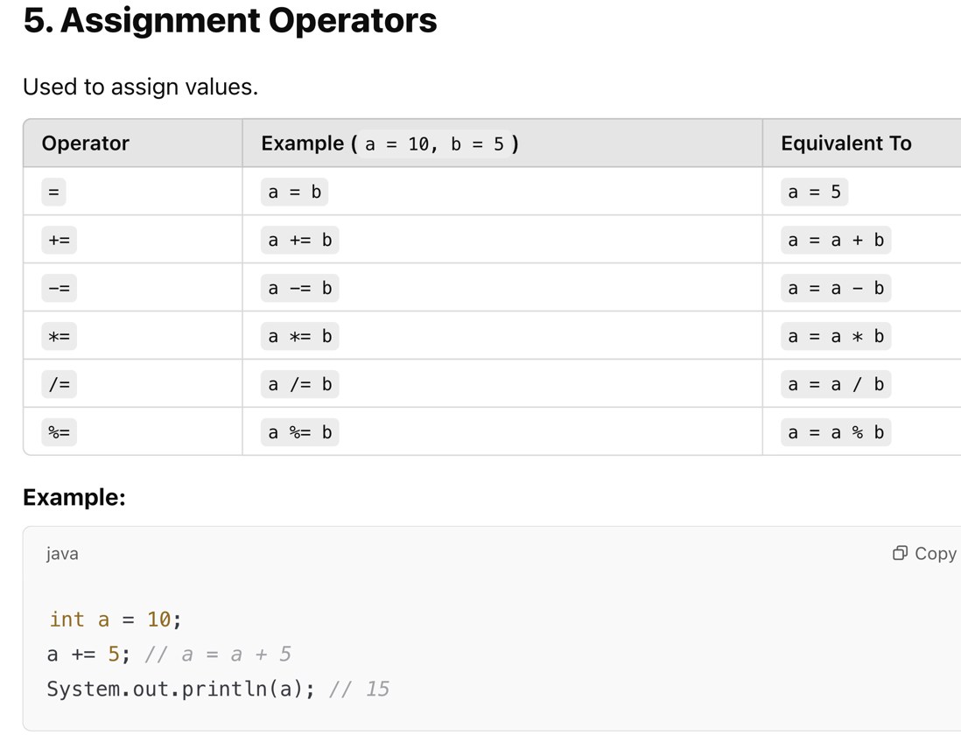

Slide 31
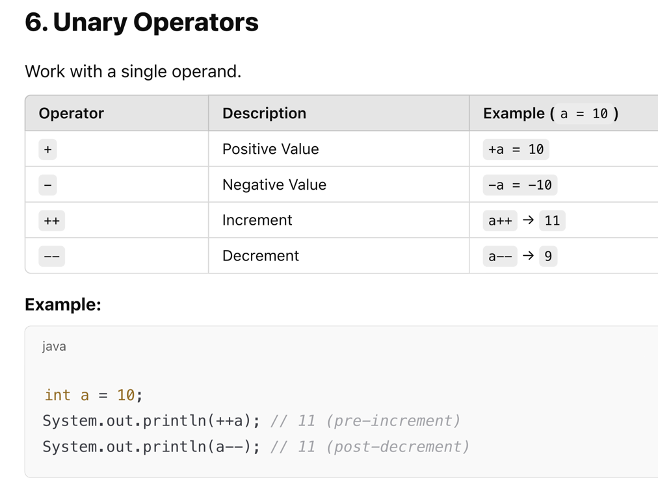

Slide 33
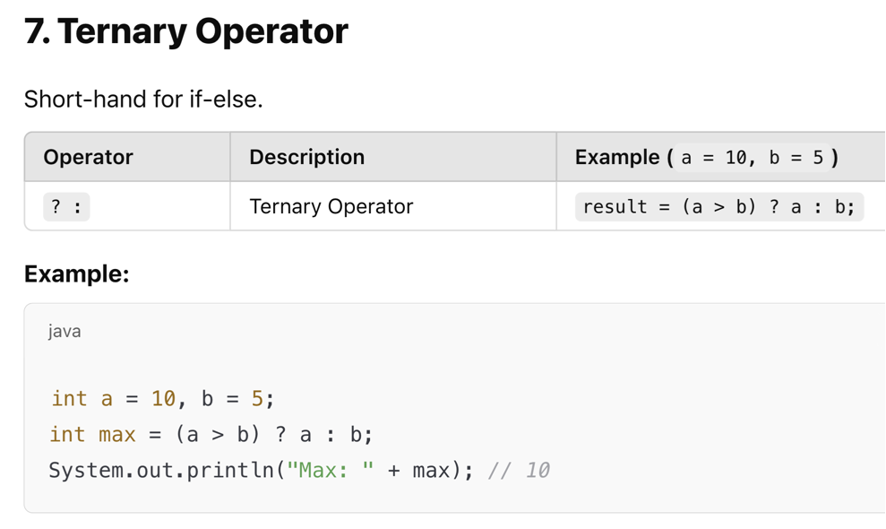

Slide 35
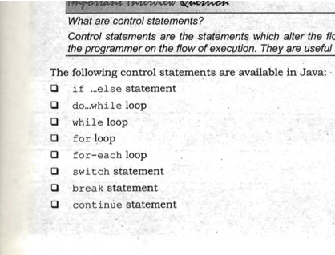
Control Statements in Java

Slide 36
Java Statements
A Java statement is the smallest unit that is complete instruction in itself.
Statements in Java generally contain expressions and end with a semicolon (;).
Statements in Java are used to define the logic of a program.
The two most commonly used types of statements in any programming language, including Java, are:
Sequential Statements These are executed one by one in the order they appear in the program.
Control Statements These statements determine the flow of execution in a program. They may be executed conditionally or repeatedly based on specific conditions.

Slide 37
Java Statements
A Java statement is the smallest unit that is complete instruction in itself.
Statements in Java generally contain expressions and end with a semicolon (;).
Statements in Java are used to define the logic of a program.
The two most commonly used types of statements in any programming language, including Java, are:
Sequential Statements These are executed one by one in the order they appear in the program.
Control Statements These statements determine the flow of execution in a program. They may be executed conditionally or repeatedly based on specific conditions.
System.out.println("Hello");
x=y+z;
System.out.println(x);

Slide 38
Java Statements
A Java statement is the smallest unit that is complete instruction in itself.
Statements in Java generally contain expressions and end with a semicolon (;).
Statements in Java are used to define the logic of a program.
The two most commonly used types of statements in any programming language, including Java, are:
Sequential Statements These are executed one by one in the order they appear in the program.
Control Statements These statements determine the flow of execution in a program. They may be executed conditionally or repeatedly based on specific conditions.

Slide 39
Java Statements
A Java statement is the smallest unit that is complete instruction in itself.
Statements in Java generally contain expressions and end with a semicolon (;).
Statements in Java are used to define the logic of a program.
The two most commonly used types of statements in any programming language, including Java, are:
Sequential Statements These are executed one by one in the order they appear in the program.
Control Statements These statements determine the flow of execution in a program. They may be executed conditionally or repeatedly based on specific conditions.
System.out.println("Hello");
x=y+z;
System.out.println(x);

Slide 40
Java Statements
A Java statement is the smallest unit that is complete instruction in itself.
Statements in Java generally contain expressions and end with a semicolon (;).
Statements in Java are used to define the logic of a program.
The two most commonly used types of statements in any programming language, including Java, are:
Sequential Statements These are executed one by one in the order they appear in the program.
Control Statements These statements determine the flow of execution in a program. They may be executed conditionally or repeatedly based on specific conditions.

Slide 41
The following are control statements in Java:
if...else statement
do...while loop
while loop
for loop
for-each loop
switch statement
break statement
continue statement

Slide 42
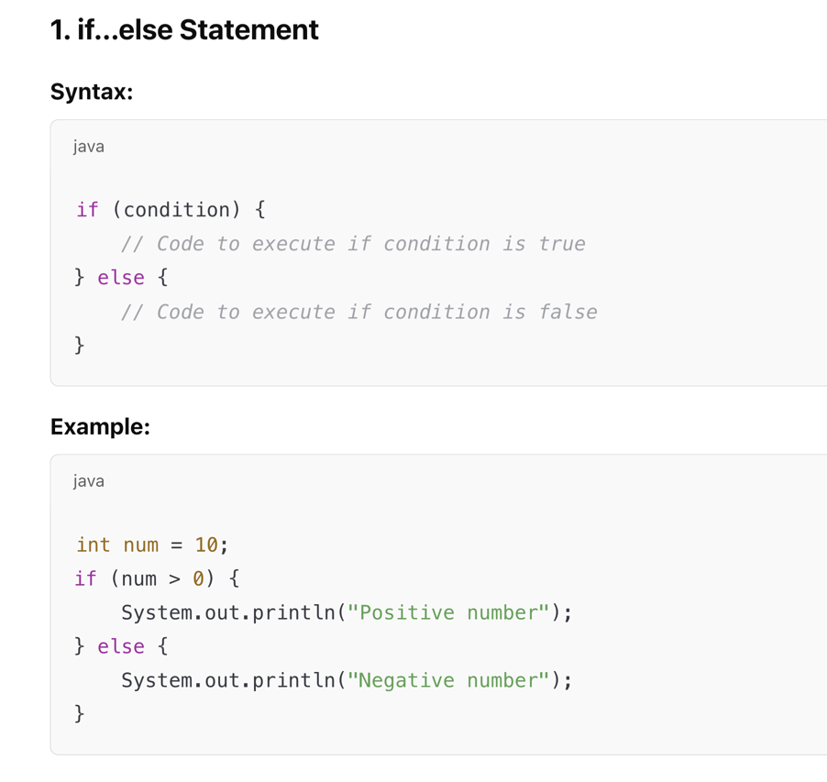

Slide 43
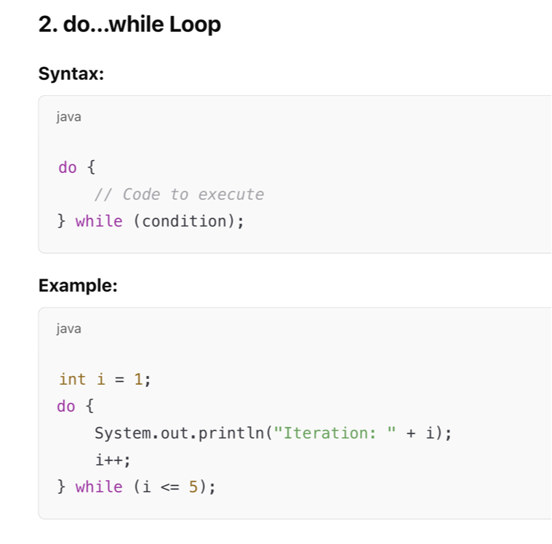

Slide 44
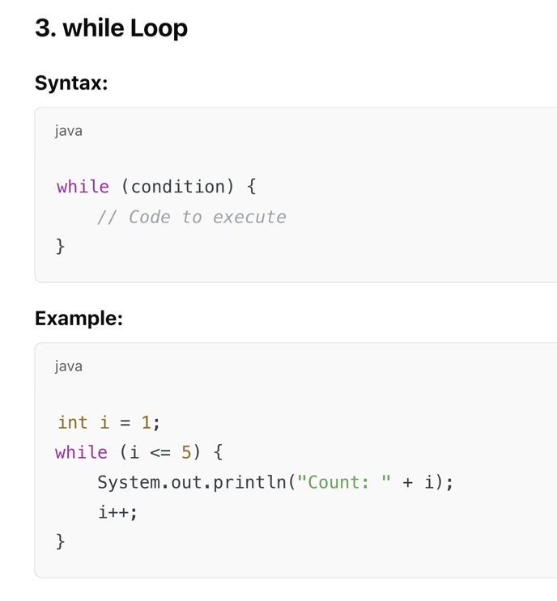

Slide 45
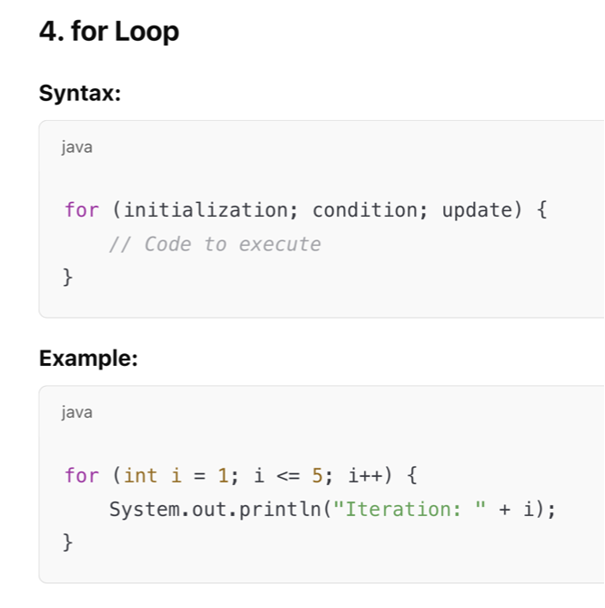

Slide 46
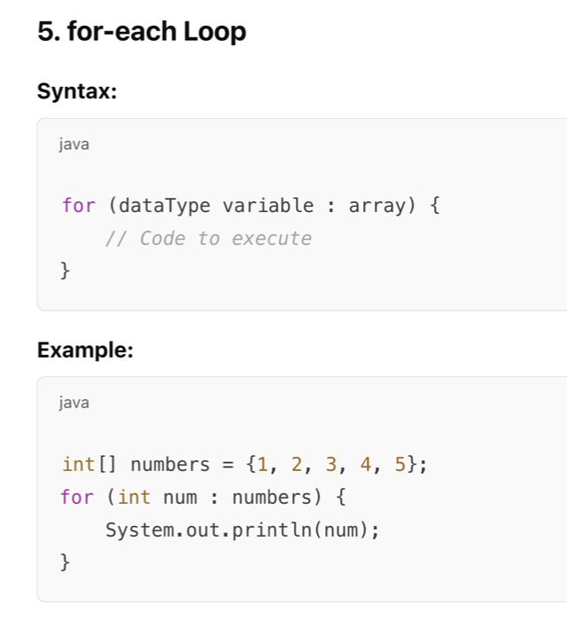

Slide 47
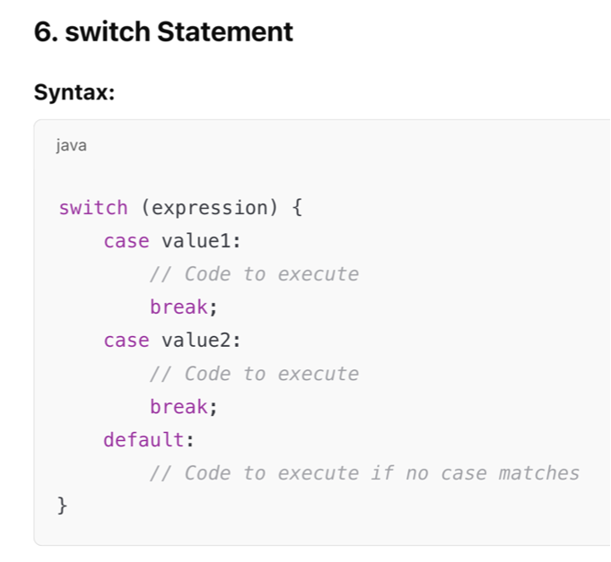
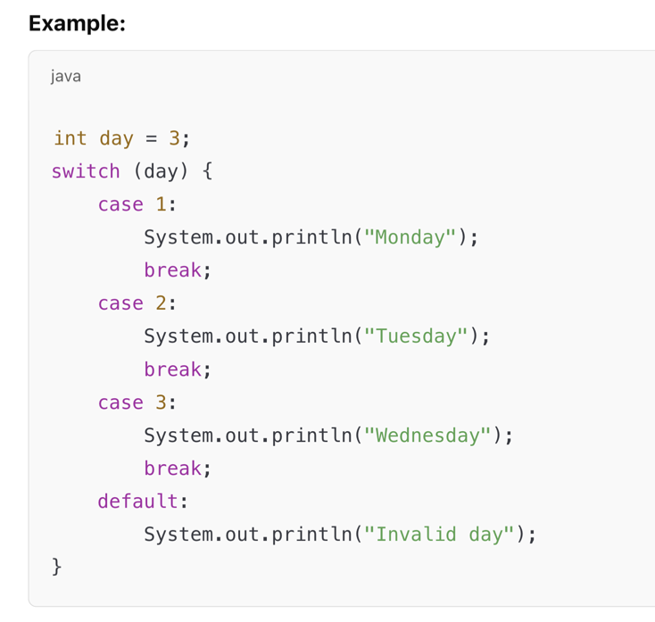

Slide 48
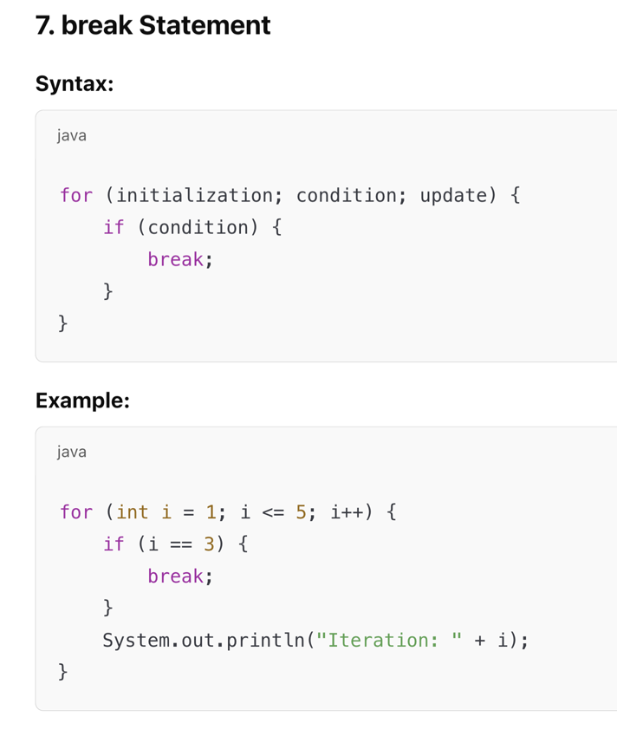

Slide 49
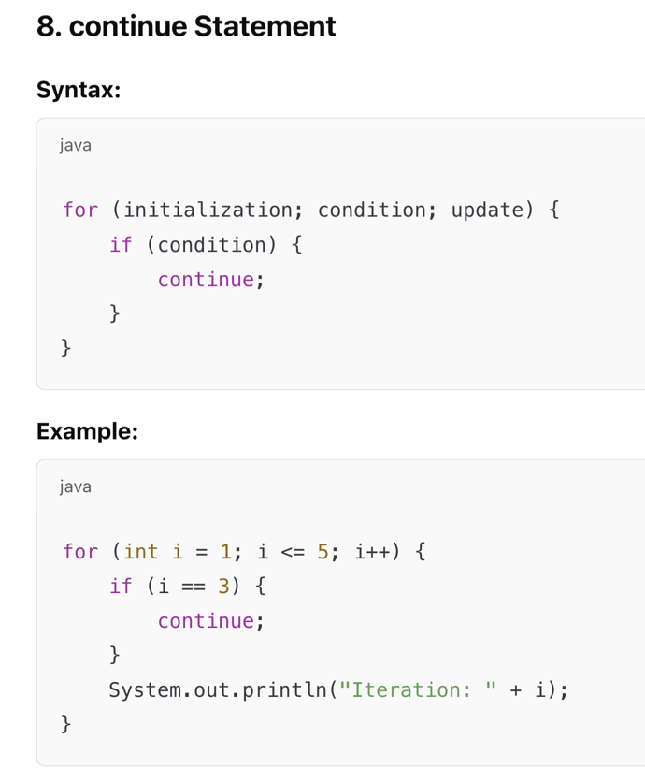

Slide 50
Out of do...while and while - which loop is efficient?
In a do...while loop;
the statements are executed without testing the condition, the first time.
From the second time only the condition is observed.
This means that the programmer does not have control right from the beginning of its execution.
In a while loop,
the condition is tested first and then only the statements are executed.
This means it provides better control right from the beginning.
Hence, while loop is more efficient than do...while loop.

Slide 51
Out of do...while and while - which loop is efficient?

